Slide 1


GitOps Deployment
GitOps Deployment: Workflow vs Agent underscores the balance between predictable and a flexible pipeline deployment, Dynamic Agent powered orchestration approach.

Slide 2

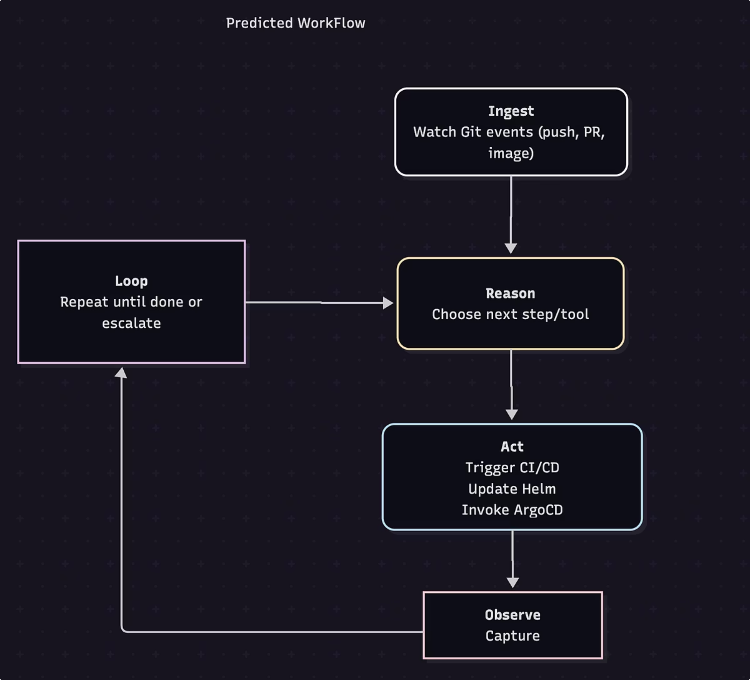




Workflow Design - Predefined GitOps Deployment
"Workflows" follow predefined code paths to orchestrate LLMs and tools.
Ingestion
Git events (push, PR, image release) as the trigger.
Automated Build & Manifest Update:
CI builds the container image and auto-updates the Git repo with the new image tag.
Release & Deployment:
A GitOps operator (e.g., ArgoCD) watches the repo and applies changes to the cluster.
Continuous Drift Detection:
The operator ensures the live cluster always matches Git, auto-fixing any drift.

Slide 3


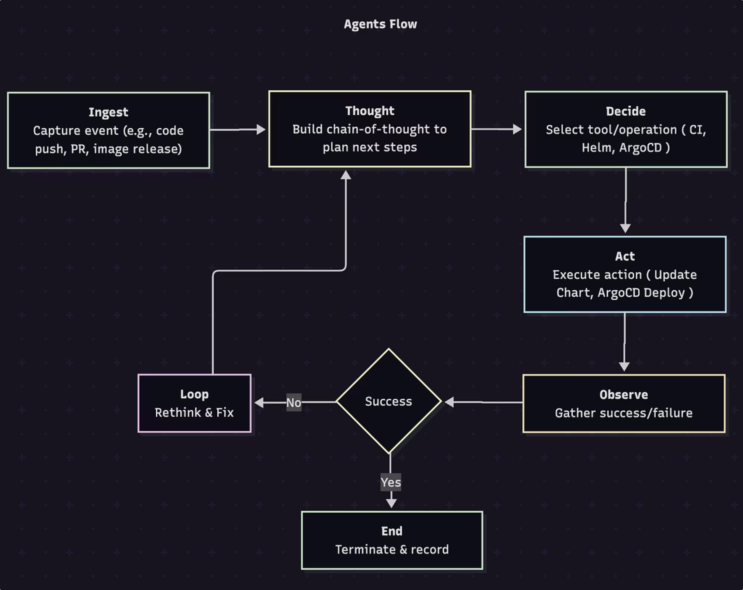






Agent Design - Dynamic Orchestration deployment
Agents allow LLMs to decide their next steps and tool usage dynamically, maintaining control over task execution.
Ingestion
Git events (push, PR, image release) as the trigger.
Model-Driven Planning
The LLM independently outlines the deployment plan, choosing steps (e.g., Terraform, Helm, ArgoCD) based on context.
Dynamic Tool Invocation
Invoke the appropriate tool - CI/CD pipeline runs, Helm value updates in Git, or ArgoCD API calls for each planned step.
Interactive Feedback Loop
Additional information when uncertainty arises.
Observation & Validation:
Continuously monitor CI results, commit statuses, and cluster health for success/failure signals.
Open-Ended Problem Solving
Adapt the plan on-the-fly to handle unexpected conditions or policy changes without a predefined path.
Final Results
Once the desired state is achieved, the agent concludes the run and logs its decisions.

Slide 4
Comparison: GitOps Deployment Workflow vs Agent
Criteria
Predective WorkFlow
Dynamic Agent
Predictability
Fixed sequence: GitLab CI → Helm values update → ArgoCD sync.
Dynamic Sequence - Reasons at runtime and invokes CI, Helm CLI or ArgoCD API.
Manifests Updates
Automated image-updater commits new tag to repo
Agent edits values.yaml or Helm charts directly in Git.
Sync Mechanism
ArgoCD polls repo on schedule.
Agent can call ArgoCD's API to reconcile instantly.
Recovery
ArgoCD enforces desired state, rollbacks on failure.
Agent observes failures, re-thinks plan, self-heals or escalates.
Flexibility
Low - Follows a strictly defined path.
High - Adapts to unexpected conditions and policy changes.
Best Fit
Regulated, audit-heavy environments needing reproducibility.
Rapid, dynamic use-cases where real-time decisions and self-healing add value.

Slide 5
When to Use Which Approach
Workflow
Agents
Auditable & Controlled: Every change is tracked and enforced via Git for full compliance.
Real-time Adaptation: Automatically bump chart versions, execute canary or blue-green rollouts, & self-heal based on live metrics.
Predictable Release Cadence: Suited to stable environments with scheduled, repeatable deployments.
Dynamic Environments: Ideal when policies, configurations, or deployment strategies can change mid-pipeline and require on-the-fly decisions.
Consistency-Focused Teams: Ideal for teams that prioritize uniform, low-variability pipelines.
Simple, Infrequent Updates: Best for straightforward applications with well-understood, occasional changes.
Automated Remediation: Suited for frequent ad-hoc fixes and error recovery without manual intervention.
Context-Driven Orchestration: Leverages an LLM to choose the right tools and actions based on current state and business rules.

